Slide 1
Data Structures And Algorithms

Slide 2
Stack using Linked List
The main advantage of using a linked list over arrays is that it is possible to implement a stack that can shrink or grow as much as needed.
Using an array will put a restriction on the maximum capacity of the array which can lead to stack overflow.
Here each new node will be dynamically allocated. so overflow is not possible.

Slide 3
Stack using Linked List
Dynamic memory allocation: The size of the stack can be increased or decreased dynamically by adding or removing nodes from the linked list, without the need to allocate a fixed amount of memory for the stack upfront.
Efficient memory usage: Since nodes in a singly linked list only have a next pointer and not a prev pointer, they use less memory than nodes in a doubly linked list.
Easy implementation: Implementing a stack using a singly linked list is straightforward and can be done using just a few lines of code.

Slide 4
Stack Implementation using SLL
To implement a stack using the singly linked list concept, all the singly linked list operations should be performed based on Stack operations LIFO (last in first out) and with the help of that knowledge, we are going to implement a stack using a singly linked list.
So we need to follow a simple rule in the implementation of a stack which is last in first out and all the operations can be performed with the help of a top variable.
In the stack Implementation, a stack contains a top pointer. which is the “head” of the stack where pushing and popping items happens at the head of the list.
The first node has a null in the link field and second node-link has the first node address in the link field and so on and the last node address is in the “top” pointer.

Slide 5
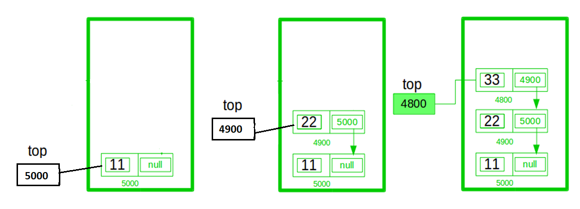
Stack using SLL (push)

Slide 6
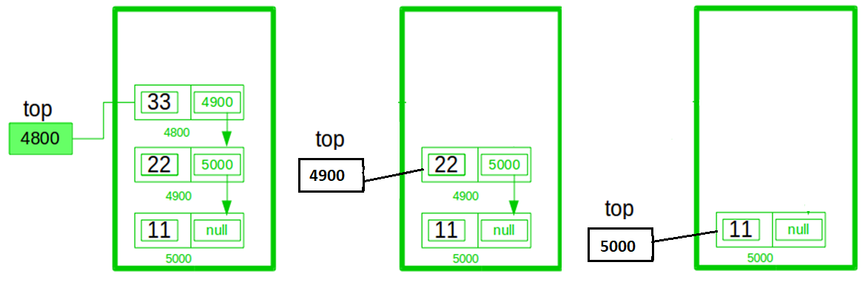
Stack using SLL (pop)

Slide 7
Queues Implementation using SLL
To implement a Queue using the singly linked list concept, all the singly linked list operations should be performed based on queues operations FIFO (first in first out) and with the help of that knowledge, we are going to implement a queue using a singly linked list.
In the queue Implementation, a queue contains two pointers, which is the “front” and “rear” of the stack.
Enqueue an item happens at the rear of the list, while dequeue occurs at front end of the list.
The last/ rear node has a null in the link field.

Slide 8
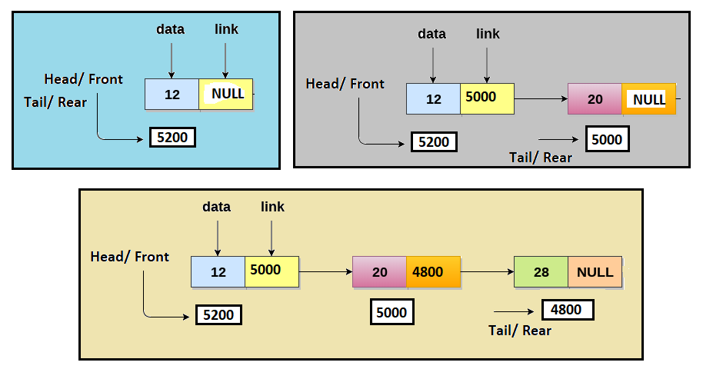
Queues using SLL (Enqueue)

Slide 9
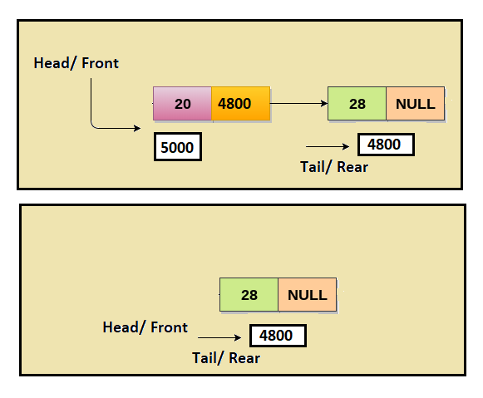
Queues using SLL (dEqueue)

